Slide 1
AUTONOMOUS WALKING STICK

Slide 2
INTRODUCTION:
Visually impaired people are the ones who are unable to perceive the objects around them through the visual sensory organ eye.
A survey by WHO (World Health Organization) carried out in 2011 estimates that in the world, about 1% of the human population is visually impaired (about 70 million people) and amongst them, about 10% are fully blind (about 7 million people) and 90% (about 63 million people) with low vision.
The main problem faced by the visually impaired is to navigate their way to their destination.

Slide 3
Existing Method:
Visually impaired people generally use either the typical white cane or the guide dog to travel.
The idea of designing and manufacturing ultrasonic sensor combines the properties of sound monition and that benefit the visually impaired.
Sensor can detect obstacles within the designed range to avoid the visually impaired person through the issuance of distinctive sound.
The existing system doesn't provide proper results and is not much effective.

Slide 4
Disadvantages Of The Existing System:
Although a normal stick gives a warning about few meters before the obstacle, for a normal walking speed, the time to react is very short.
Other systems like systems with ultrasonic sensor may not prove to be efficient enough as it would warn only about an obstacle on the path and would not specify the size of the object for the person to move accordingly.

Slide 5
Problem Statement:
The need to facilitate easy movement for the visually impaired without having to depend on others

Slide 6
Objectives:
To make a solution that helps the visually impaired to move around freely
To make the solution fast, efficient and easy to use with a shallow learning curve
To calculate the distance between the visually impaired and object accurately
To build and run a Deep Learning model to detect all objects in the frame

Slide 7
Proposed System:
The proposed model attempts to design a system whereby obstacles are detected in front of the user using sensors and where obstacles are currently using a camera.
The proposed system will perform image captioning on the scene captured through the camera using a Convolutional Neural Network (R-CNN) model and ssd_mobilenet model.

Slide 8
Advantages of Proposed System:
It can detect any obstacle with the help of ultrasonic sensors and camera module, which allows the user to detect the distance of the object from them and also identifies the object using modern algorithms like Faster R-CNN.
The system is that it helps the visually impaired indoors and outdoors
The information regarding obstacles is given through voice alerts, eliminates the difficulty of understanding vibration patterns which was used in earlier systems.
The system is low budget navigational aid for the visually impaired.

Slide 9
Methodology:
This system works using Raspberry Pi, Ultrasonic Sensors, Camera Module, Bluetooth module and Bluetooth headphones.
The Raspberry Pi triggers the ultrasonic sensor to start sending the burst signal. Here all the actions start the process at the same time, so it does not cause any delay between any action.
The ultrasonic sensor sends a trigger (trig), if there is an obstacle in the path, the wave reflects back and hits the echo drum.

Slide 10
Methodology (cntd.)
The model takes live feed from the camera and analyses the image frame by frame to detect the objects.
All results are converted to audio format and fed to the visually impaired for easy use
Raspberry pi sends the information to Bluetooth module and the instructions is received by the user by Bluetooth headphone

Slide 11
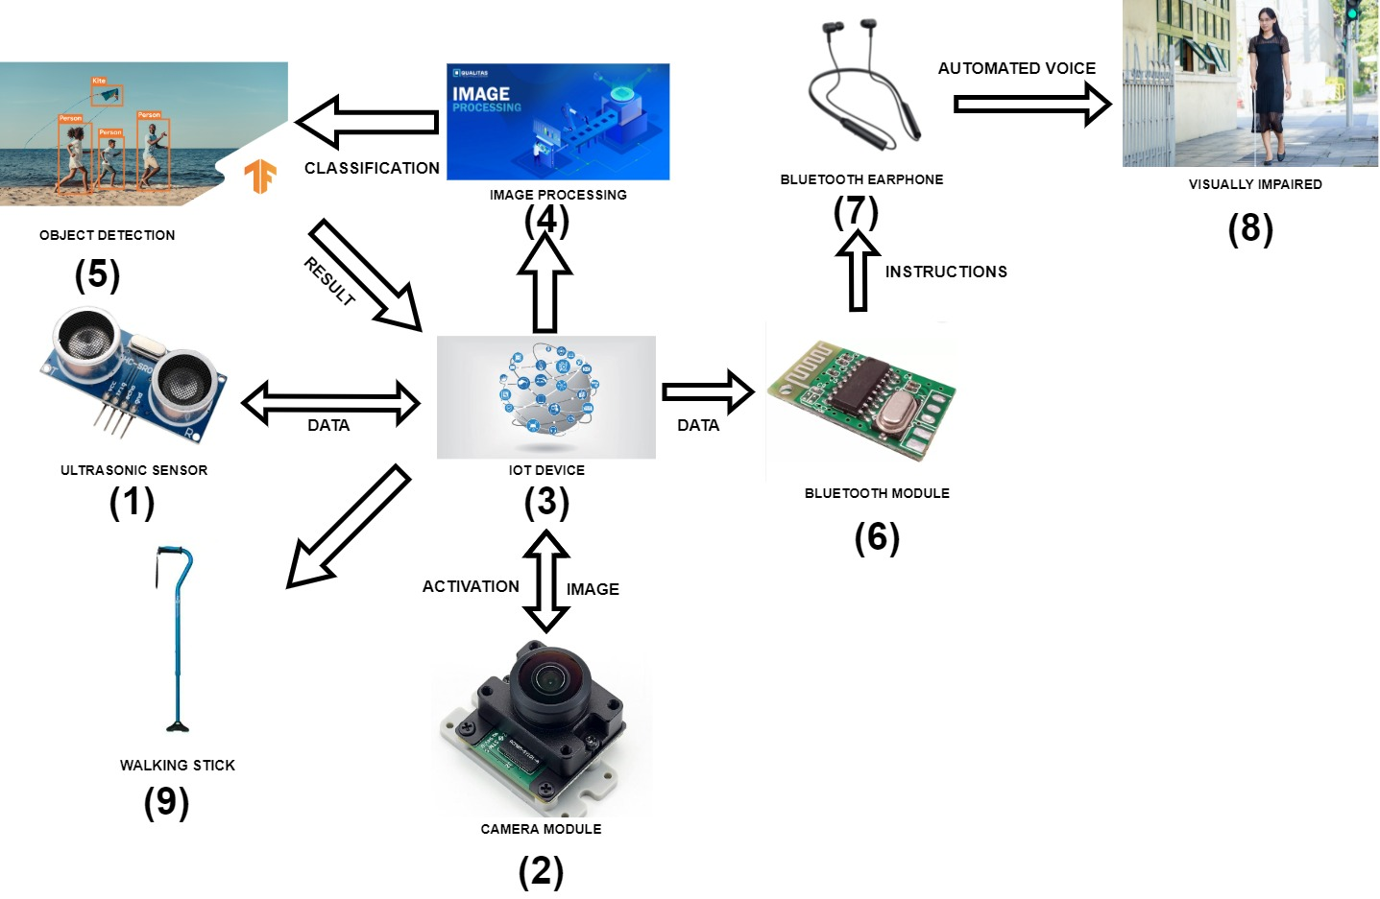
Architecture Diagram:

Slide 12
Data Flow Diagram
.

Slide 13
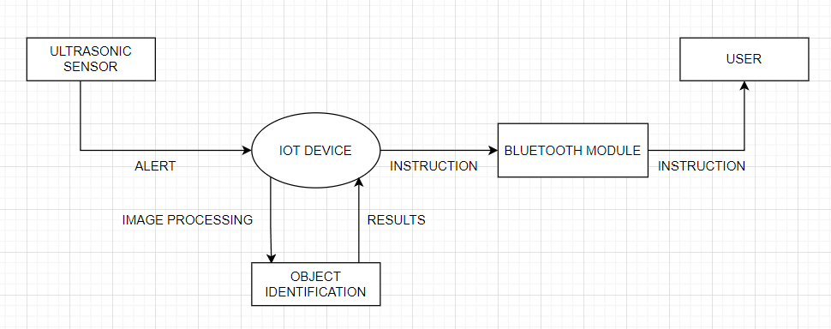
Level 0

Slide 14
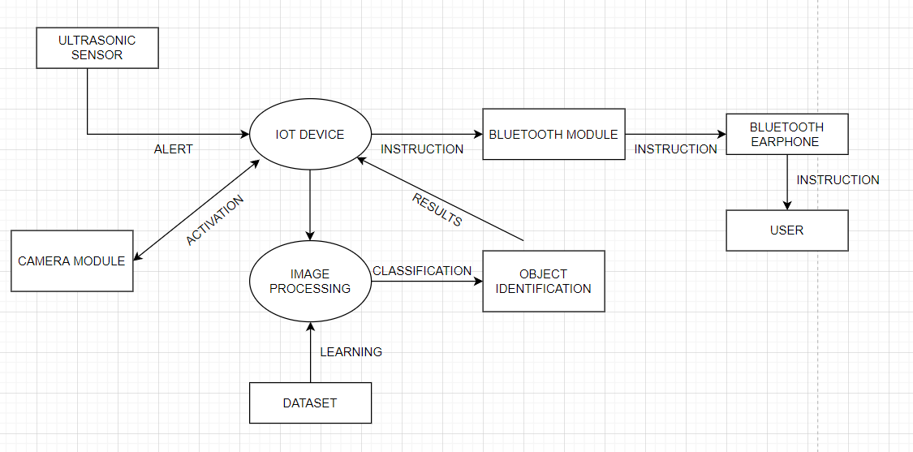
Level 1

Slide 15
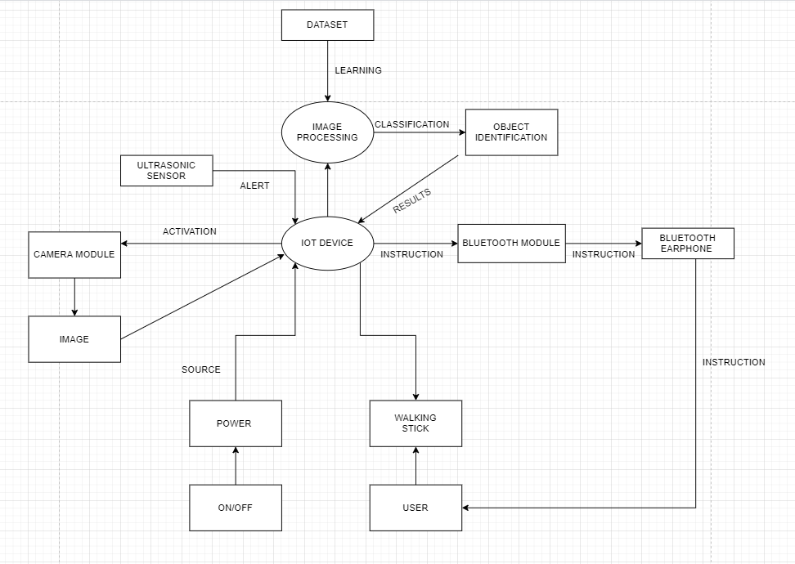
Level 2

Slide 16
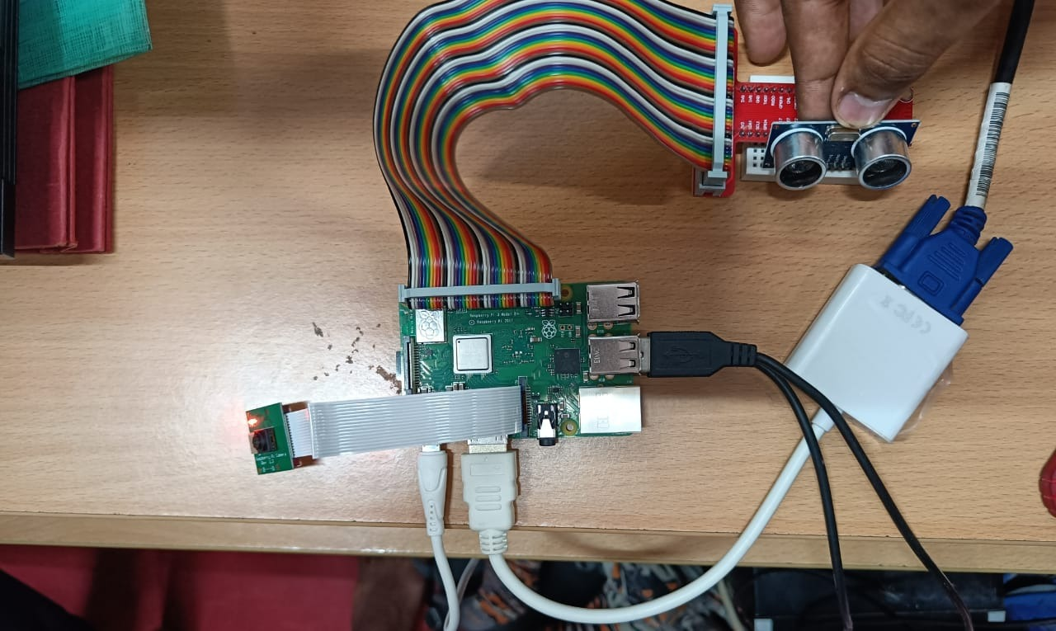
Results and Discussion:

Slide 17
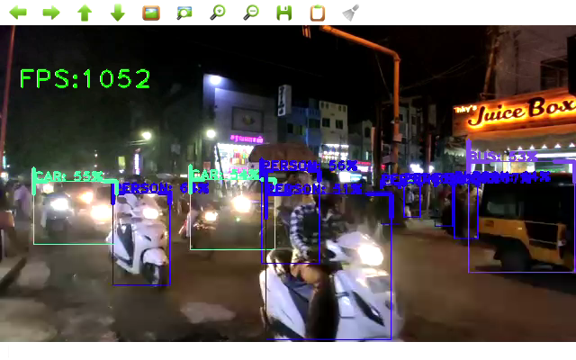
Results and Discussions:

Slide 18
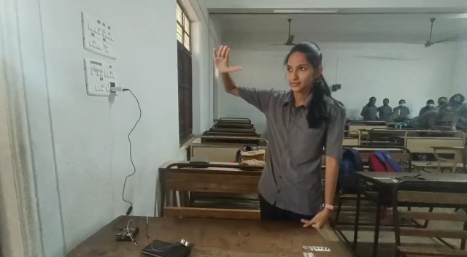
Results and Discussions:

Slide 19
Results and Discussion:
Hence we have developed a solution that detect objects and the distance between the visually impaired and the object.
We have used ssd_mobilenet and mask_rcnn_inception_resnet models to detect the obstacles in the path
We have used Raspberry Pi to calculate the distance between the user and the obstacle
All results are converted to speech and fed to the user in real-time

Slide 20
Contribution:
The smart walking stick is more advance, easy to maintain, cheap, durable.
With the help of smart walking stick blind, elderly people can advance more than 15-20% travel speed, reduce minor collision; do not lose their way, and increase safety and confidence.
Blind and elderly users can move confidently without any dependence on other person with the help of this smart stick.

Slide 21
Conclusion:
The smart walking stick, constructed with utmost accuracy, will help the blind people to move from one place to another without others help.
The accuracy of the object detection and transmission of signals are enhanced in our new proposed system.
The smart stick detects objects or obstacles in front of users and feeds warning back, in the form of voice messages rather than vibration.
Hence, Blind and elderly users can move confidently without any dependence on other person with the help of this smart stick. With the help of this walking stick user will feel secure and independent.

Slide 22
Future Work:
Our future work will focus on enhancement of object recognition system so that it can detect and identify objects better in challenging environmental conditions.
The walking cane shares the current location of the user using GPS navigation and passes the information to the people who wants to monitor them using a mobile application.
An emergency SMS and call can be forwarded to emergency contacts that are saved to the APP by pressing the power button four times in 5 s.

Slide 23
References:
https://www.ncbi.nlm.nih.gov/pmc/articles/PMC6339061/
https://transmitter.ieee.org/makerproject/view/7feb1
https://www.researchgate.net/publication/338037207_Design_and_Implement_A_Smart_Blind_Stick
https://www.researchgate.net/publication/343186221_Smart_Stick_For_the_Blind_Using_Arduino
https://nevonprojects.com/ultrasonic-blind-walking-stick-project/
https://www.instructables.com/Smart-Blind-Stick/

Slide 24
Outcomes:
Helps visually impaired walk without fear or depending on others.
This project uses ultrasonic sensor and camera at the same time so the user can get the distance between the object and themselves along with the object to move accordingly
Raspberry Pi is a small, low power device hence making it portable

